Slide 1
Zowe CI/CD, Infrastructure Review
Notes:
Closing Slide

Slide 2
Agenda
Recap
Current Infrastructure
What and how we build
Limitations
Open Infrastructure
Goals
Adjustments
Status
What’s Next?

Slide 3


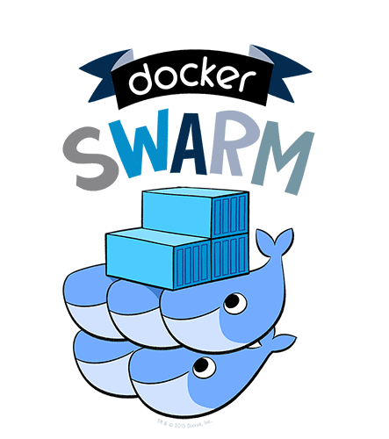

Current Infrastructure
Public Read Access
wash.zowe.org
github.com
Zowe repos
backup
jayne.zowe.org
* Jenkins v2.138.1
Limited Read Access
jayne.zowe.org
wash.zowe.org
gizaartifactory.jfrog.io
Artifactory v6.0.2, which is a cloud service sponsored by JFrog and running on AWS
Softlayer zOSaaS
Download / upload
Artifacts
Softlayer zOSaaS
* IBM z/OS v2.3, z/OSMF v26

Slide 4
Zowe’s Build and Pipeline Strategy
Pipeline is an overloaded term – both covering the lifecycle of a product from source to delivery, and specific meaning within Jenkins as a build definition format.
Continuous integration and deployment. Every build should run unit and integration tests which results in an artifact available for consumption through Artifactory.
This applies to component builds as well as convenience deliverables.
Dependencies between components and builds are managed through artifact coordinates.
Nightly builds for disruptive, compute-intensive activities
Smoke Tests run nightly against the latest convenience PAX.
Project-wide scans will run nightly
System tests are limited in the current infrastructure – they are run primarily in-house.
Weekly or Manual builds for corner-case activities
For example, running Smoke Tests or Project Scans against specific branches not covered in Nightly builds.
Goal: Normalize our build technology and processes across the different components of the Zowe framework.
Leverage Jenkins pipelines (Jenkinsfile).
Follow best practices outlined above.
From source to convenience binary on zowe.org, we should have virtually no manual activity besides selecting builds for promotion.
We are close to this goal. Our current manual activities involve promotion and final release activities such as GPG signing the binaries.

Slide 5
Limitations
Our Softlayer zD&T instance has limited performance capabilities, and is an emulated z/OS environment.
Additionally, there is only one instance.
We are unable to run system tests with full confidence and frequency.
We are unable to test (using community infrastructure) against other standard security subsystems in the Mainframe world – TSS/ACF2.
Limited systems configurations – single LPAR, not sysplex-aware.
We have some onboarding issues for developers/extenders looking to access our binaries, as Giza Artifactory is not public.
Workarounds exist, but are not ideal

Slide 6



Solution?

Slide 7
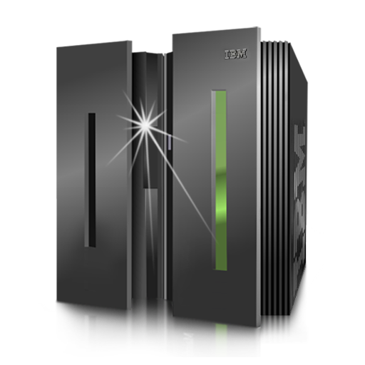
Open Infrastructure
Distributed
github.com
Jenkins Master
Zowe repos
Build Agents – Docker Enabled
Zowe Artifactory
* Jenkins (version managed)
Transition off this infrastructure
Transition to this infrastructure
Softlayer zOSaaS
z/OS Guest LPARs
Mainframe

Slide 8
Open Infrastructure Goals
z/OS
Improve the performance of our existing z/OS builds – packaging, smoke tests, etc.
Gradually roll-out system tests as part of the regular CI/CD process. Execute a subset of component system tests on infrequent cadence (nightly), increasing our component coverage first and subsequently our system test cadence.
Adjust as we go based on the performance of the open infrastructure.
Careful! Pull Requests should never run system tests unless authorized, we do not want contributors running arbitrary code on these systems.
Increase automated coverage of installation/configuration tests across security subsystems. We will have ACF2, Top Secret, and RACF z/OS Guests available (1 of each).
Distributed
Completely open visibility into our build/test/deploy processes.
Completely open Artifact repositories – no more onboarding developer workarounds.
Hand over hosting and software maintenance for build infrastructure to the Linux Foundation.

Slide 9
Open Infrastructure Adjustments
Migrating to the new infrastructure will result in some changes to our process
Any system maintenance or configuration changes will require an issue opened in LF JIRA: https://jira.linuxfoundation.org/servicedesk
This includes credential entries in Jenkins
Less direct administrative capabilities within the open community
Some administrative capacity on the Marist LPAR, however, access will be limited and any actions performed on the system must be logged with Marist.
As well as to code -
Jenkins jobs are defined through a Jenkins plugin called “Jenkins Job Builder”.
These jobs are specified in a YAML format in a new repository: https://github.com/zowe/ci-management
Pipeline-as-code (Jenkinsfile) will require label and keyword adjustments, but should otherwise run exactly as they do today.
And logs!
Any logs or data which is generated by z/OS as part of a build must stay on z/OS.

Slide 10
Open Infrastructure Status
Linux Foundation Jenkins / Agent Cloud
Up and available – https://Jenkins.zowe.org and https://Jenkins.zowe.org/sandbox
Linux Foundation Artifactory
In progress
Linux Foundation S3 Bucket
Artifact hosting – in progress and coming soon!
Marist LPAR
Up and available with RACF
Zowe 1.3.0 and 1.4.0 tested on this LPAR, we plan to convert install and smoke tests to this LPAR in the coming weeks.
Top Secret and ACF2 pending
Zowe DockerHub
Up and available – https://hub.docker.com/u/zowehub
Zowe Website
https://zowe.github.io , coming soon!

Slide 11
What’s Coming Next?
Improving automation for project wide scans
Security, License, Dependencies, Performance, etc.
Distributing and driving our build pipeline library
Available here for inspection: https://github.com/zowe/jenkins-library
Simplify writing building pipelines and built-in features which align with Zowe’s branching and release strategies
Drive transition to the new Open Infrastructure
Any support and enablement work for Zowe 2.0
Review and organize Docker images used within the community’s build and test process
Review repositories in the Zowe community ( 97! )

Slide 12

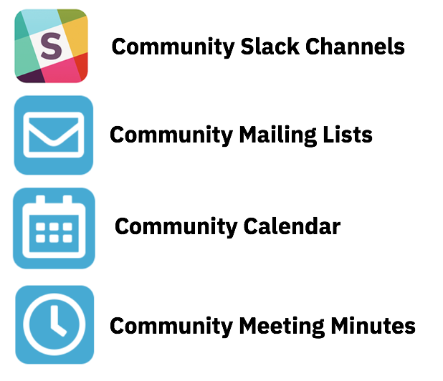
Getting Started with …
Project Community site
https://zowe.org
Access to Beta Download
https://zowe.org/download
Review Zowe squads, missions and activities
https://zowe.org/contribute/
Code Guidelines
https://zowe.org/code-guidelines/
Project Governance
https://zowe.org/about-us/
GitHub
https://github.com/zowe
Project Documentation (includes user and install guides)
https://zowe.github.io/docs-site/
Developer Tutorials
https://zowe.github.io/docs-site/guides/intro.html
https://developer.ibm.com/tutorials/zowe-step-by-step-tutorial/

Slide 13
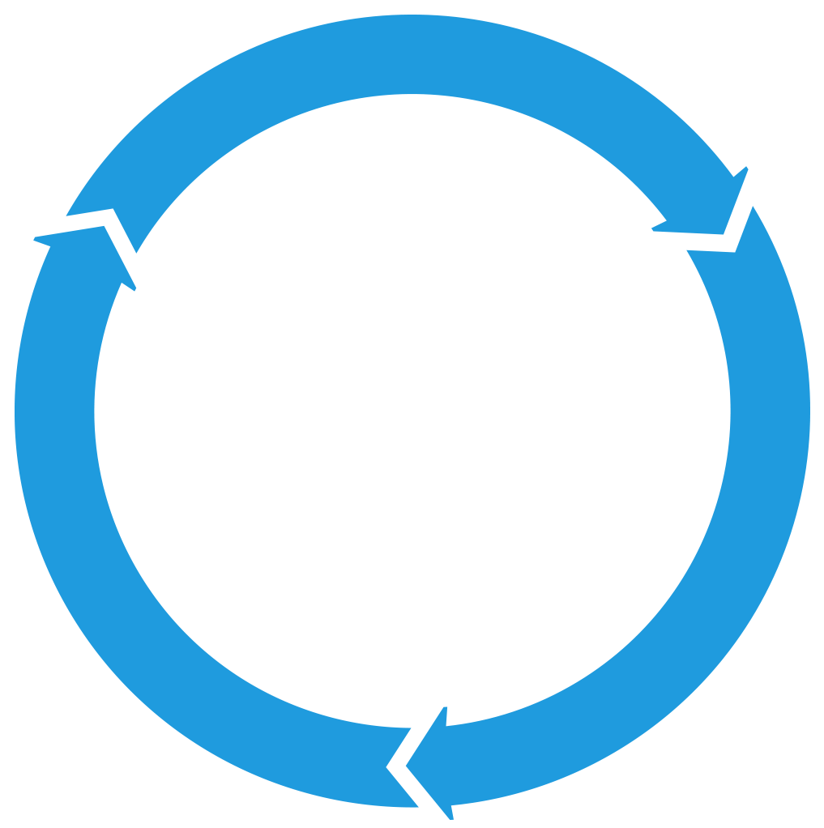


Get involved in the Zowe community
Join Open Source Community @ https://www.openmainframeproject.org/projects/zowe
PROJECTS
Participate in and contribute to the Zowe developer community at zowe.org
Learn how your organization can become a steward and supporter of this project with Open Mainframe Project membership at openmainframeproject.org/about/join
DEVELOPER
COMMUNITY
PLATFORM
PARTICIPATION
Ecosystem
PROFITS
PRODUCTS
PROMOTION
SOFTWARE
Notes:
Closing slide

